Slide 1
Basics of e-commerce

Slide 2

What is e-commerce?
"e-commerce" means using the Internet or related technologies for any of the normal business operations.
The use of information and communication technologies to transform business processes and to take advantage of the many features of the Web environment
Using ICT for buying, selling, advertising, production, distribution or management.

Slide 3
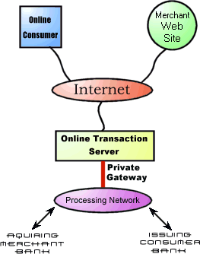
Working of e-commerce model

Slide 4
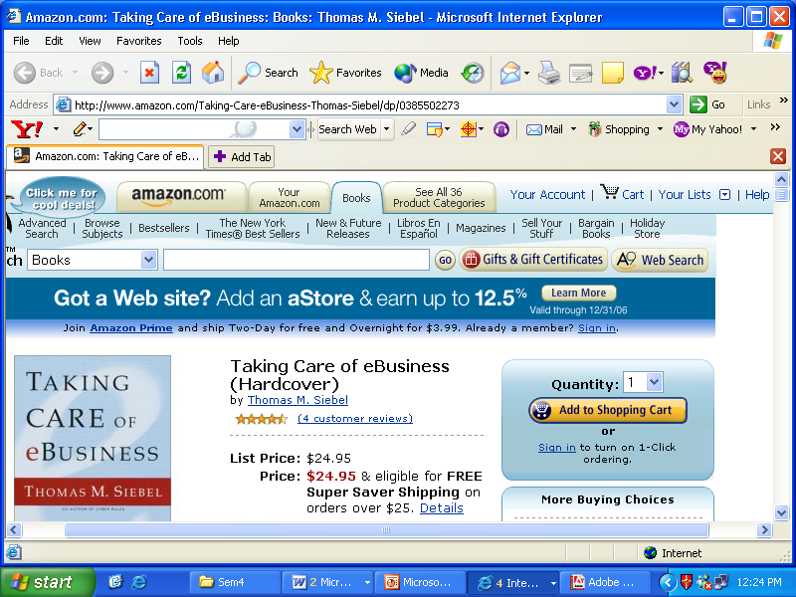

Slide 5
Evolution of e-commerce
Transaction-oriented e-commerce during 1990’s
Customer-Centric e-commerce

Slide 6

Features:
Customer is the king
Entry barriers are low
It leads to disintermediation: infomediaries are there
Economies of scale depends upon number of transaction

Slide 7
Traditional business vs. e-commerce
Product-centric (Focus on product differentiation and innovation) | Focus on customers (Customers are a part of designing the product e.g. P&G Advisors program)
Proper analysis and processing of data not possible. | Collection, storage and dissemination of information is more important as volume of data is high
Limited geographical regions | Across the globe

Slide 8
Formed from a combination of the words information and intermediary, an infomediary is a Web site that gathers and organizes large amounts of data and acts as an intermediary between those who want the information and those who supply the information.
The infomediary is a neutral entity, a third-party provider of unbiased information; it does not promote or try to sell specific products in preference over other products. It does not act on behalf of any vendors.
Another type of infomediary, and one that is not necessarily Web-based, is one that provides vendors with consumer information that will help the vendor develop and market products. The infomediary collects the personal information from the buyers and markets that data to businesses. The advantage of this approach is that consumer privacy is protected and some infomediaries even offer consumers a percentage of the brokerage deals.

Slide 9
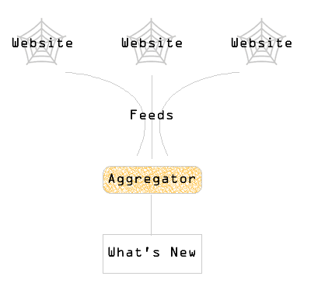
Infomediaries
Websites that are replacing the distributors and dealers.
From the simple role of a search engine, they have evolved into 3 models:
1. Aggregators: It can selectively extract information from a Web site, couple it with additional data from other sources including those of its competitors, and make the necessary fine-tuning for intelligent comparisons.
2. Online auctioneers
3. Online exchanges

Slide 10
Basic rules of e-commerce:
Know your customer
Profiles and preferences
Combination of products and services to be offered.
Best methods for customers support
Marketing efforts for different segments
New products and services that should be developed

Slide 11

Segment customers
Using e-commerce segmentation can be done on the basis of the complex factors also such as channel preference, profitability, etc.
Collaborative segmentation is also possible, where customers can choose from a flexible menu of offerings, configure them to suit their preferences and select the segment they fit in.

Slide 12
Avoid the ‘Silo’ effect:
The scattered information across different files, in different formats and at different locations is known as ‘Silo’ effect.

Slide 13
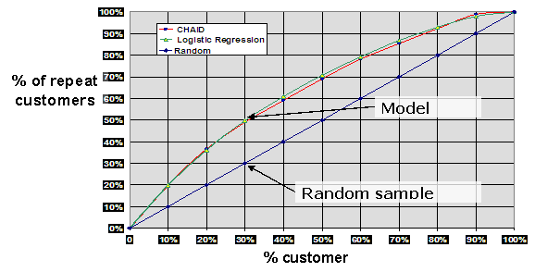
Predictive modeling
Building models for the future on the basis of existing information on customer behavior.
How much money a customer will spend on your products?
How likely someone is to respond to an offer?
How likely someone is to stop using your services?

Slide 14
Multi-channel strategy
Identify customer channel preference
Synchronize channels for seamless integration
Understand the cost structure of each channel

Slide 15
Personalize the customer experience:
Individualize the content
Enable customers to customize the environment

Slide 16
Optimize the value of every customer:
Macro level-optimize the lifetime customer value.
Micro level- optimizing the value for the individual customers by offering the most suitable products and for the organization by increasing revenues.

Slide 17
e-commerce infrastructure:
Centralized data storage
Update information dynamically
Focus on back-office systems
Scalable systems
Support all platforms and devices
Support global implementation

